Slide 1


Spatial Epidemiology of
Tick-Borne Disease in Kansas

Slide 2

Spatial Epidemiology of Tick-Borne Disease in Kansas
These slides are designed to help you learn more about Epidemiology of Tick Borne Disease in Kansas.
READ all the information on the slide.
Underlined words have a link to more information.
When you see press the cursor on your keyboard to see questions/tasks you must complete.
Record your work where instructed.

Slide 3
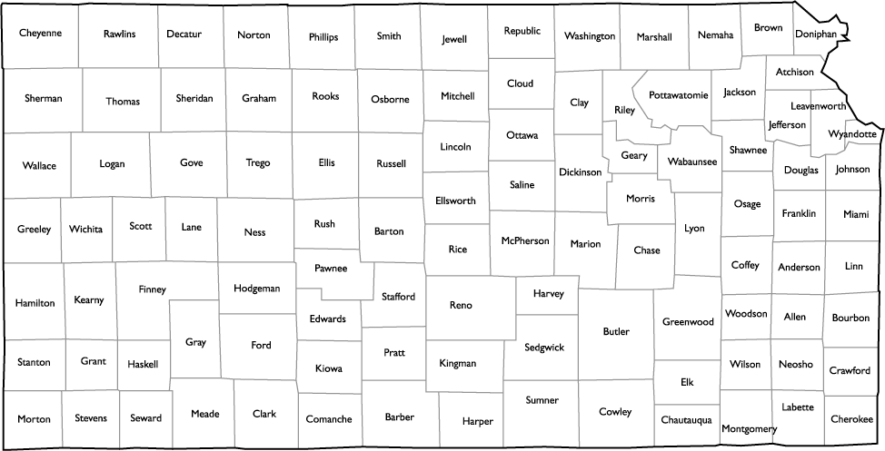
Your mission:
The epidemiologists at the Kansas Department of Health and Environment (KDHE) do not have time to analyze and publish some of the data they collect. They need your help!
Your objectives are:
Use MSExcel or Numbers to analyze the KDHE tick-borne disease data.
Design a pamphlet used to inform public of the spatial epidemiology of tick-borne diseases in Kansas.
to continue
Define epidemiology and epidemiologist.
Define spatial epidemiology.

Slide 4
Statistical Analysis of Data
Visit KS KDHE Cumulative Case Reports to find Case Reports for 2014, 2013 and 2012.
Eureka! You found it and you are ready to begin crunching numbers.
on your keyboard to continue
In MSExcel or Numbers, Google spreadsheet or you own data table record the number of cases of each tick borne disease in Kansas during 2014
When finished recording all numbers, on your keyboard to continue
In MSExcel, Numbers, Google spreadsheet or your own data table record the number of cases of each tick borne disease in Kansas during 2013
When finished recording all numbers, on your keyboard
In MSExcel, Numbers, Google spreadsheet or your own data table record the number of cases of each tick borne disease in Kansas during 2012

Slide 5
Statistical Analysis of Data (cont.)
Continue calculating!
Use your spreadsheet or calculator to calculate the total Tick-Borne Diseases in Kansas in each year: 2012, 2013, 2014.

Slide 6
Statistical Analysis of Data (cont.)
Now you’re ready to graph your results.
Before you begin, think about some interesting relationships you observed while crunching the numbers.
to continue
Check to make certain your graphs contain:
a caption that explains what the graph contains including the source of the data
axis titles
legend (if necessary)
Use MSExcel, Numbers, Google spreadsheet or graph paper to construct 4 graphs to show the public important information about tick borne disease in Kansas.
Some comparisons to consider: disease by year, year to year, disease to disease

Slide 7
Statistical Analysis of Data
Visit KS KDHE Case Reports by County for 2014, 2013 and 2012. These data are on spreadsheets. When you click on link at KDHE, you will download the spreadsheet.
on your keyboard to continue
Use the Case Reports by County to design a spatial epidemiology map of tick-borne disease in Kansas for 2014, 2013 & 2012.
Be certain to include a legend/key for your map.

Slide 8
Public Health Pamphlet Design
As an epidemiologist you might decide to go into Public Health. An important goal of public health is to inform the public about disease.
Your graphs and map contain information about tick-borne disease important for Kansas residents. Educating the public regarding health issues is referred to as Public Health. One way professionals in public education “get the word out” is to put the information in a free pamphlet.
on your keyboard to continue
Design pamphlet to make available for the public to educate citizens about tick-borne disease in Kansas
Your pamphlet should include:
title, necessary terminology, necessary text, photos, graphs, maps & resources

